Slide 1


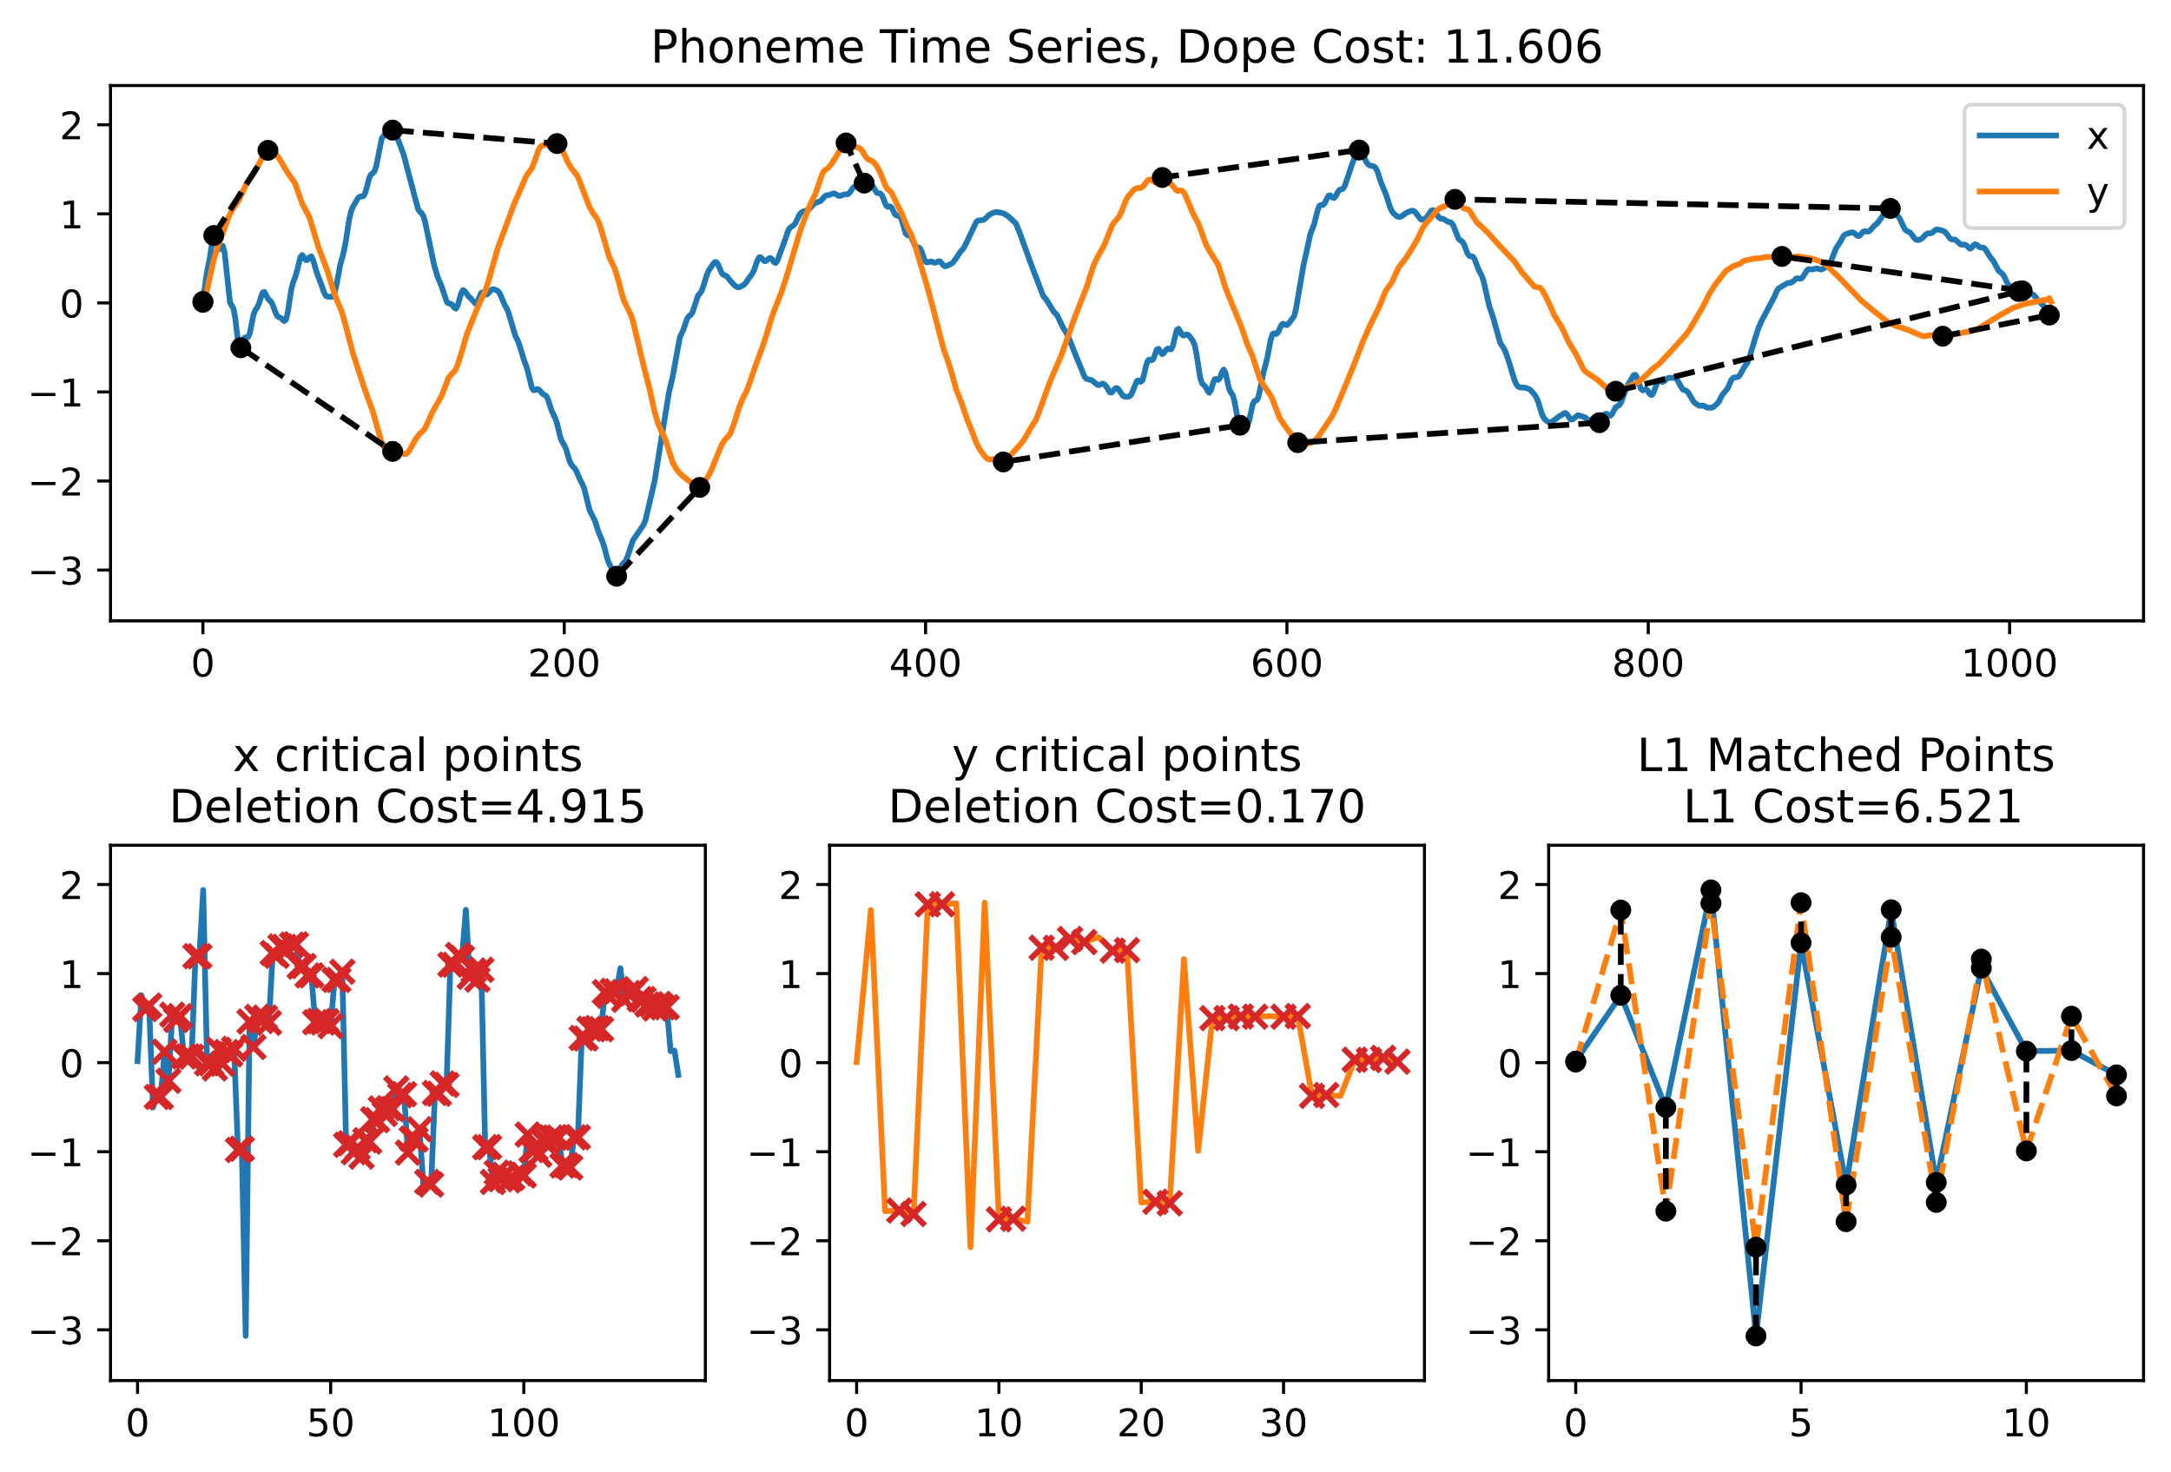
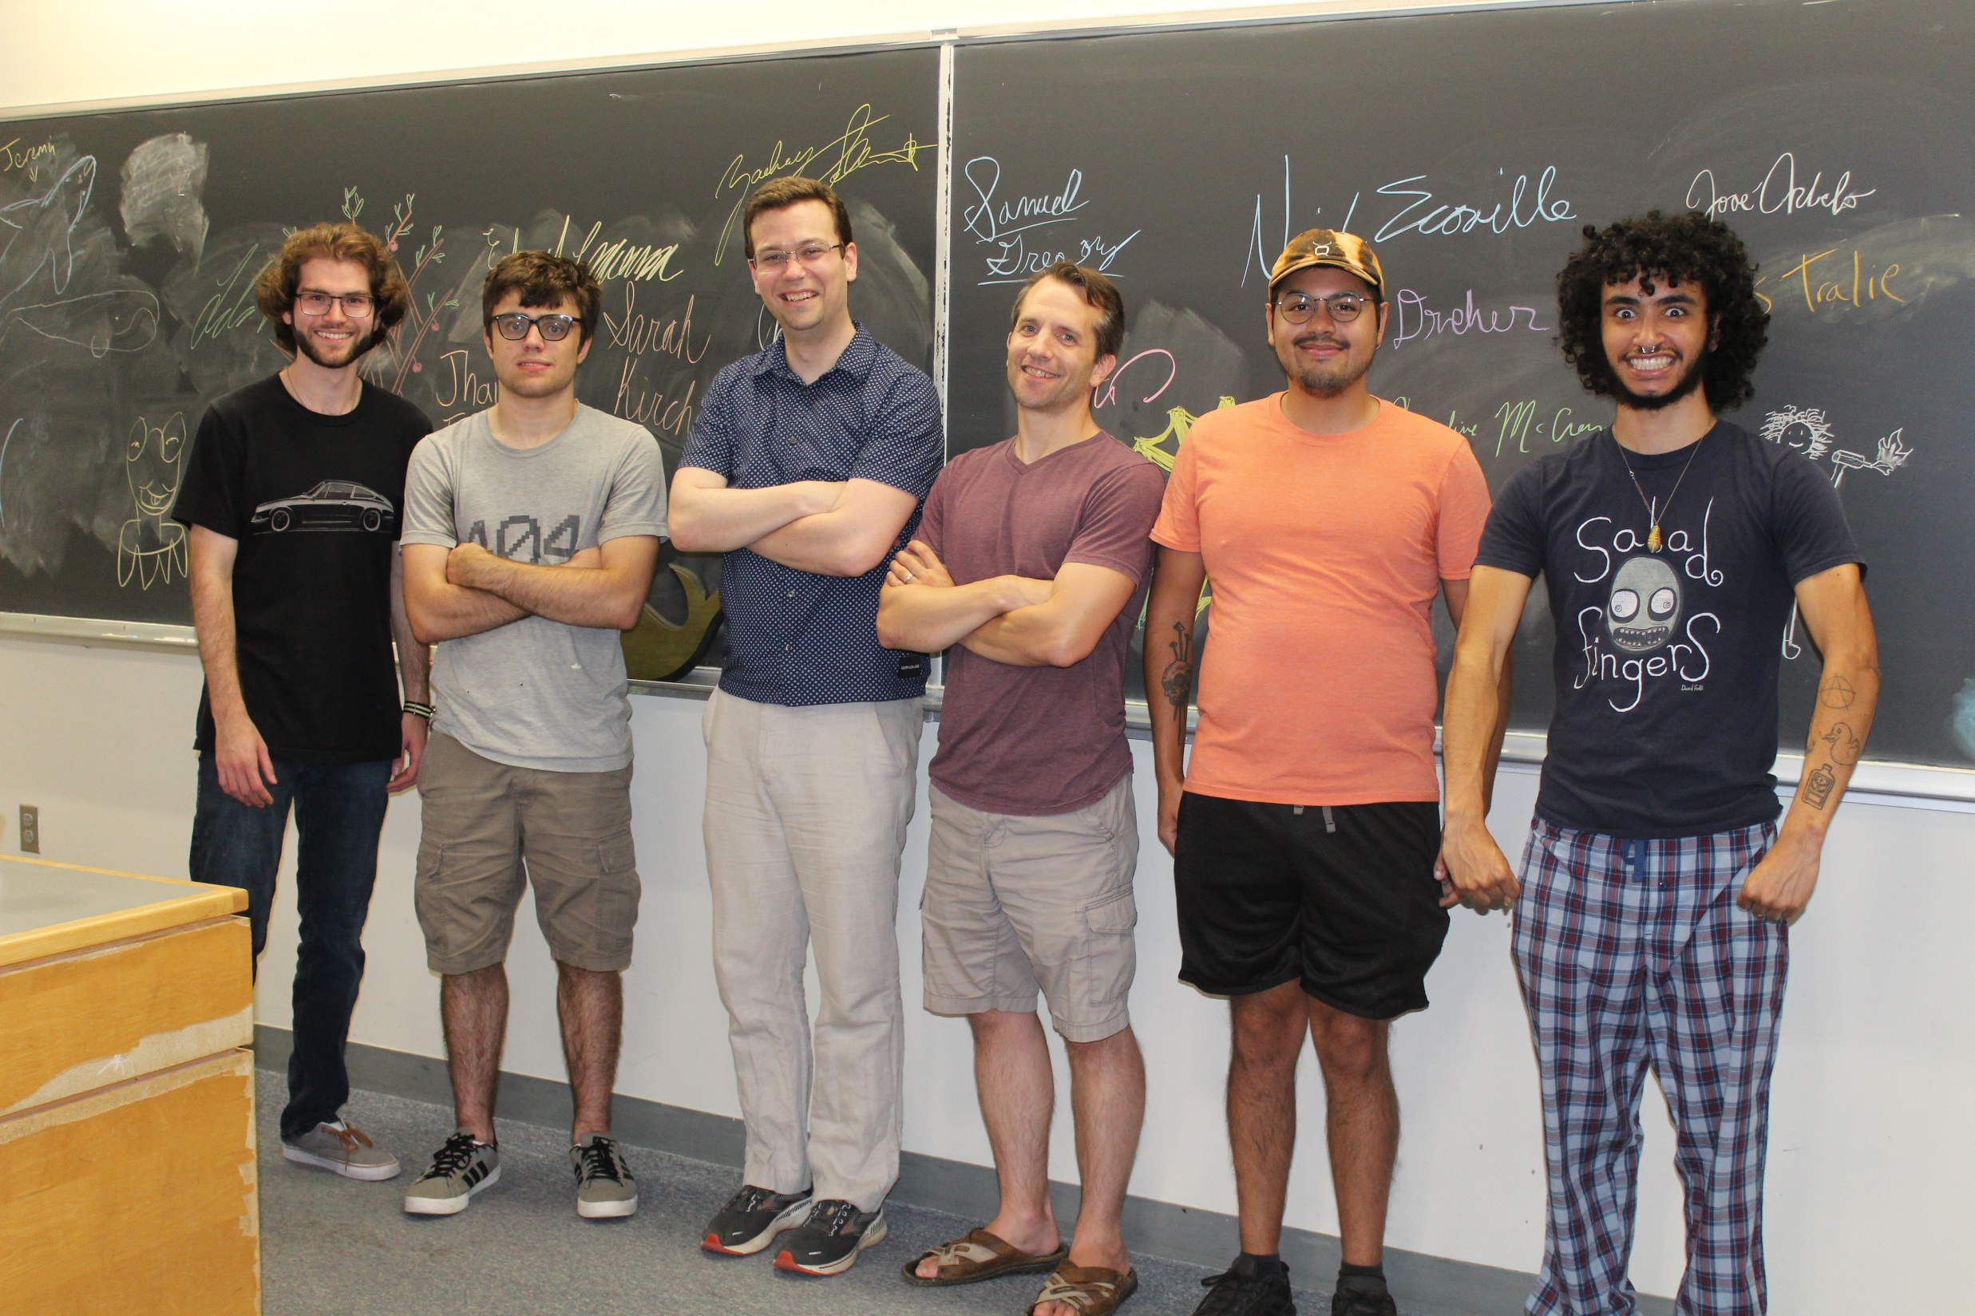
The DOPE Metric is SIC: A Stable, Informative, And Computable Metric for Ordered Merge Trees And Time Series
Zachary Schlamowitz, Charley Kirk, Christopher Tralie, Nicholas Scoville, Jose Arbelo, Antonio Delgado
Ursinus College Math/CS REU 2022

Slide 2
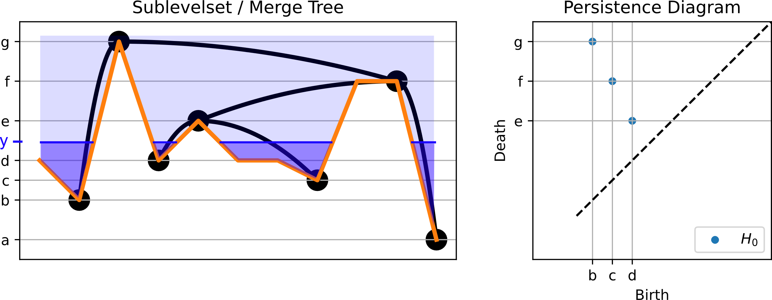
Merge trees / Sublevelset filtrations
Equivalence relation (x₁, y) ~ (x₂, y) iff (x₁, y) is path connected to (x₂, y) in S_{f}(t)
Notes:
Before we go any further, we should discuss what a merge tree is. A merge tree is (generically) a binary tree used to summarie a scalar function on some domain X. Intuitively, it tracks connected components of pools of water as the water level rises. A point on the merge tree is an equivalence class of points that are the same height in the same pool of water. So you’ll notice, for example, at a height of y here, there are 4 pools of water, and so there are 4 points at that slice of the merge tree. New pools form at local mins of the function, which are leaf nodes in the tree, and two pools merge together at saddle points of the function, which show up as internal nodes in the tree. All of this information can be summaried in a structure known as a persistence diagram. Each pool of water that exists individually at some point in this watershed process shows up as a point in the diagram. The point’s x coordinate is known as its “birth time,” which corresponds to the local min where it formed, and its y coordinate is known as its “death time,” which is the saddle point where it merged with something else. When two pools merge, the one that was born later dies first, or the so-called “elder rule”

Slide 3
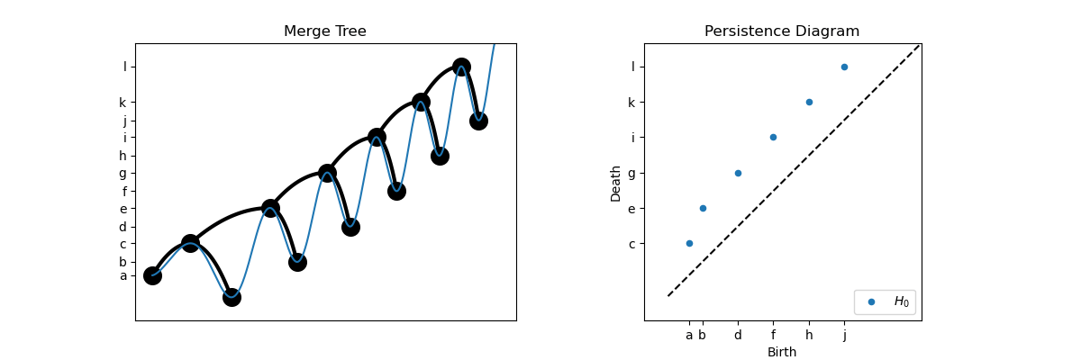
Motivation: Time Warping
Merge trees are invariant to domain homeomorphisms

Slide 4
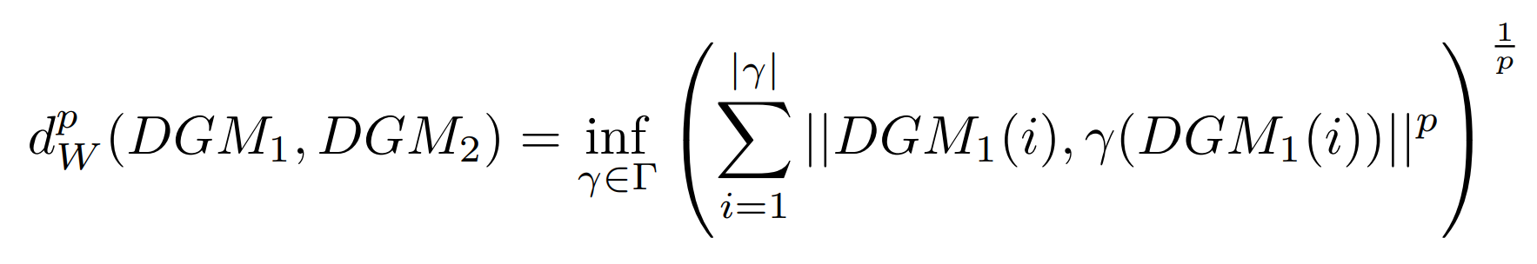
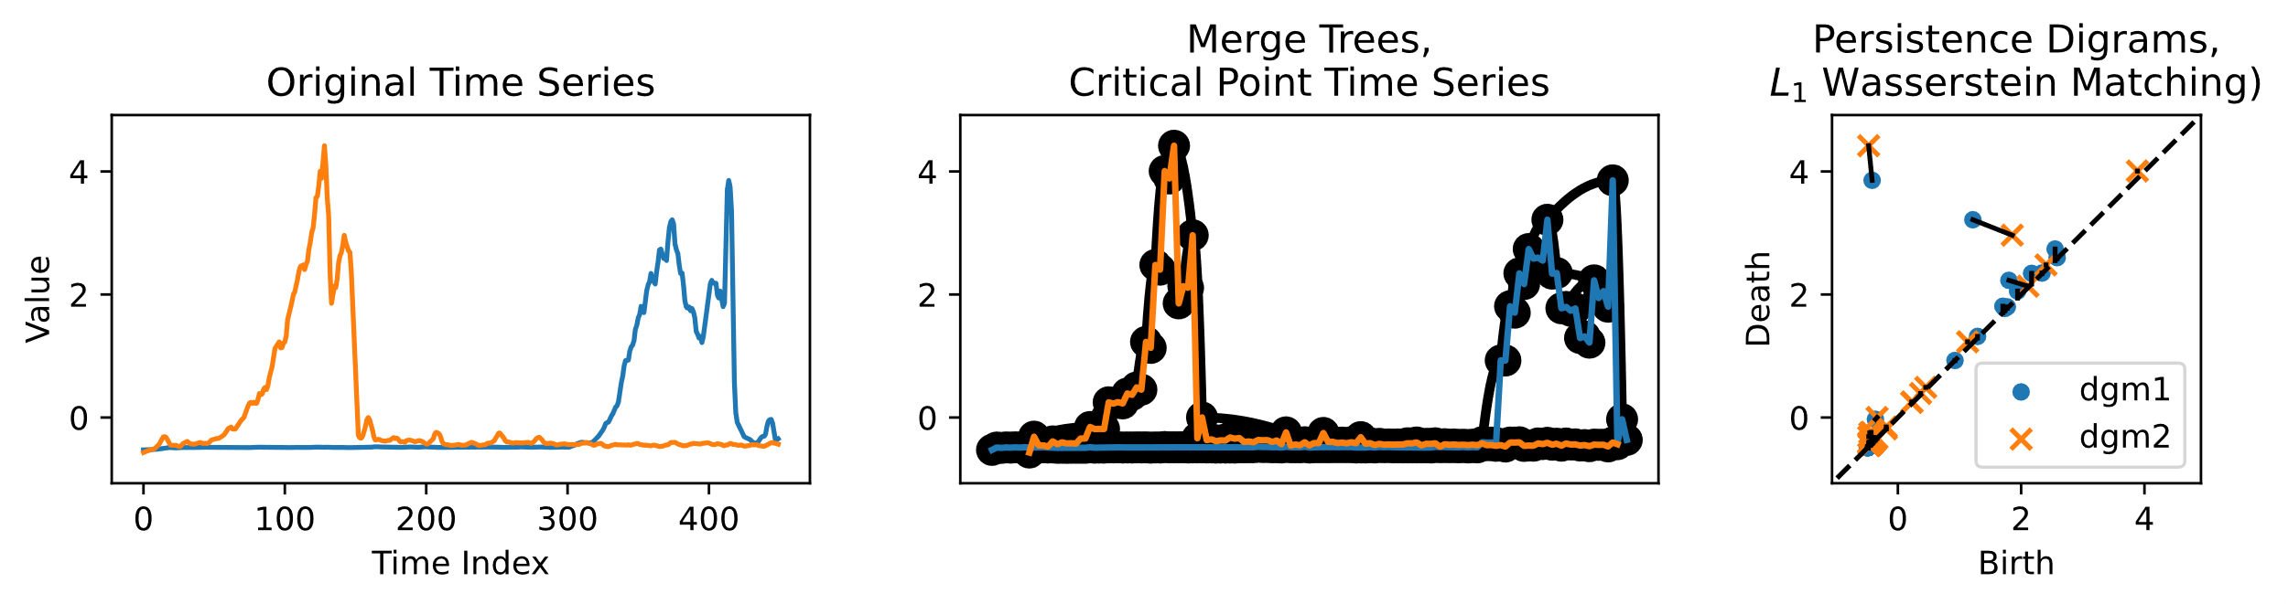
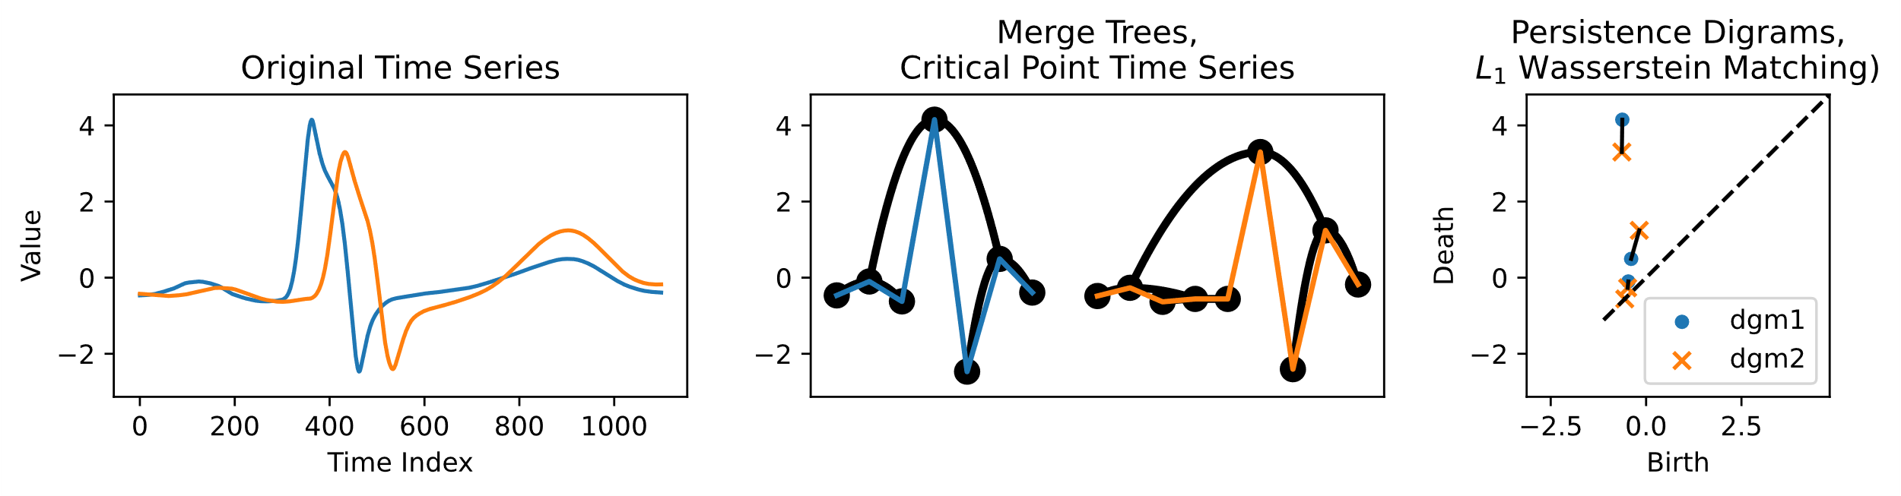
Wasserstein Distance
Lp optimal transport distance between diagrams, pulling points from diagonal
UCR
Lightning
UCR
ECG

Slide 5
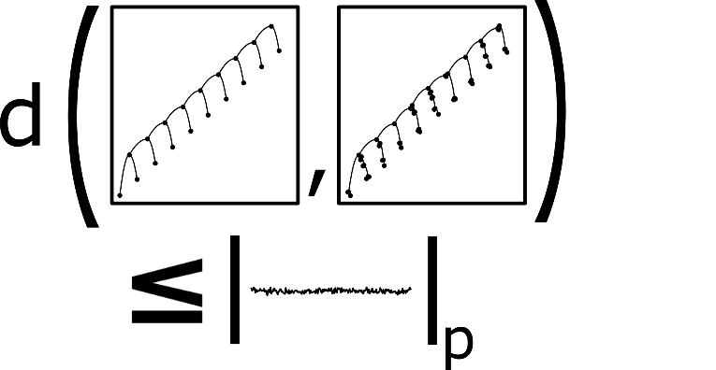
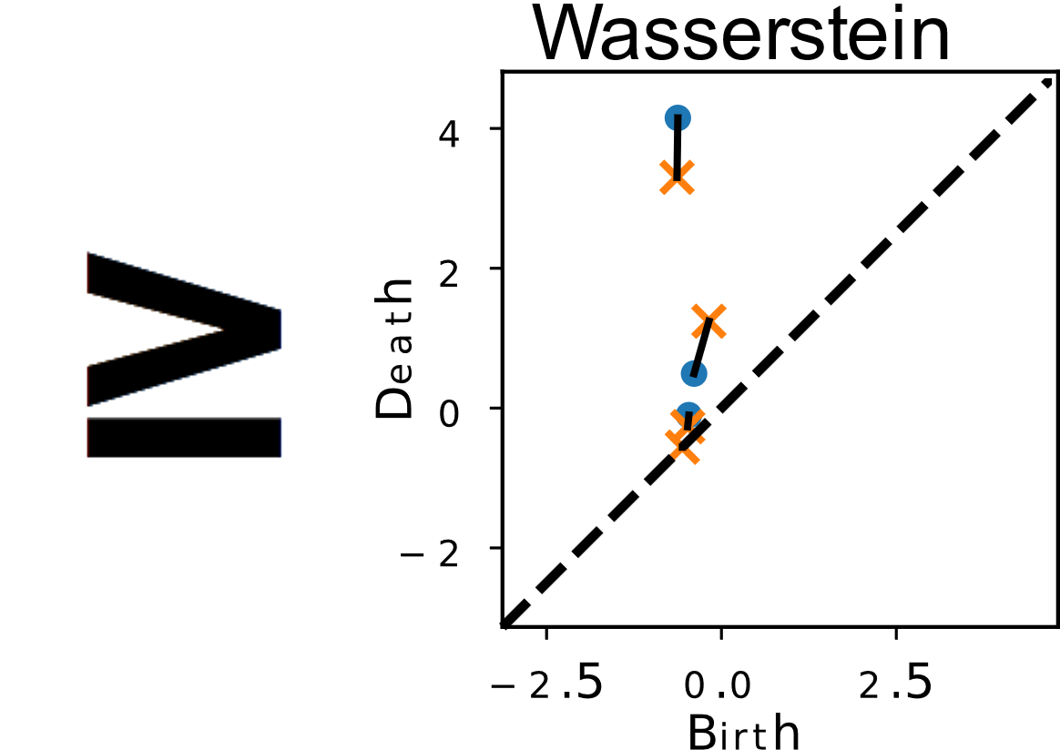
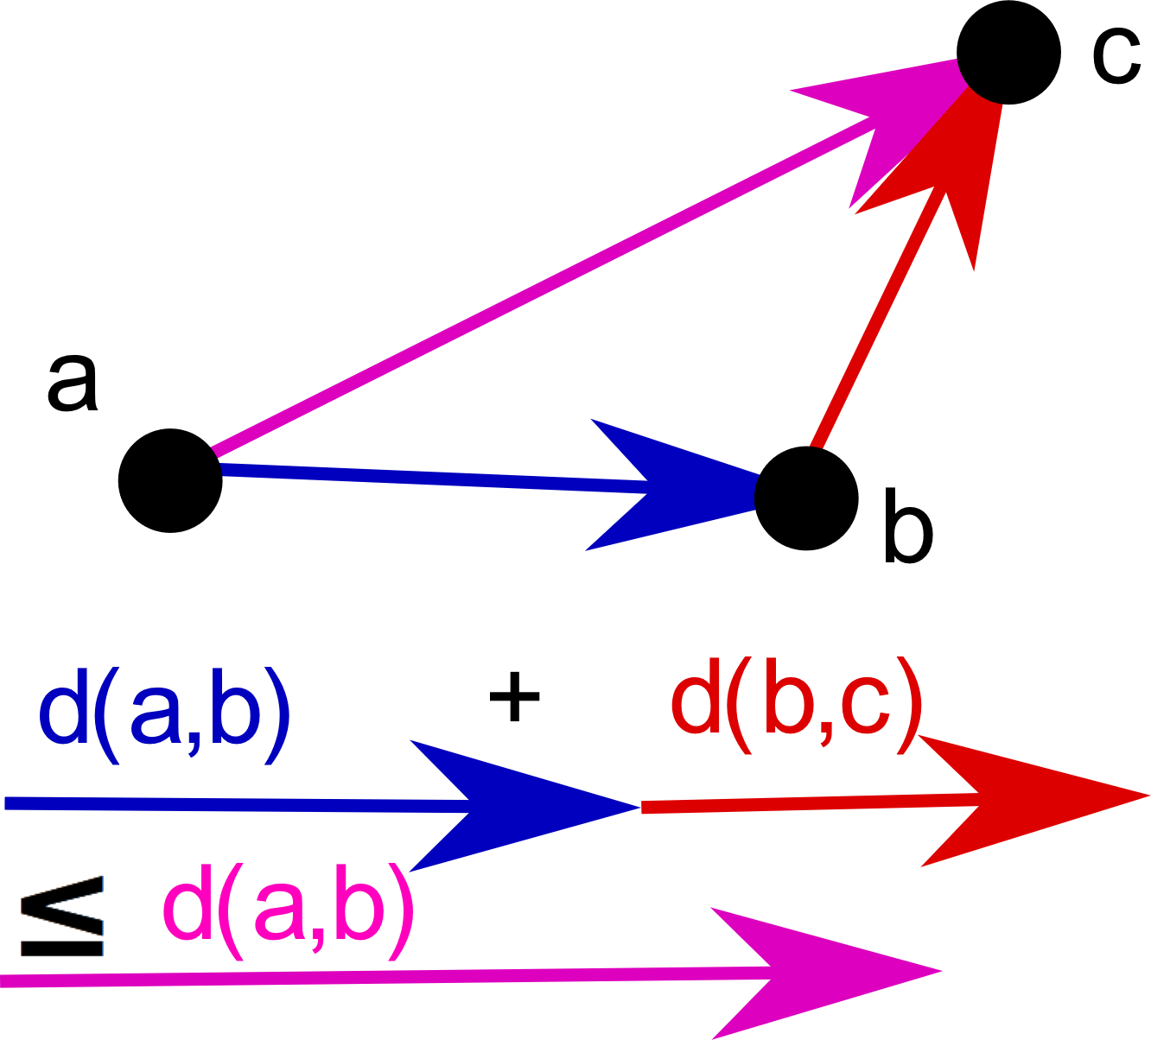

Desired Properties
p-Stable
p-Informative
p-
Metric
Computable

Slide 6
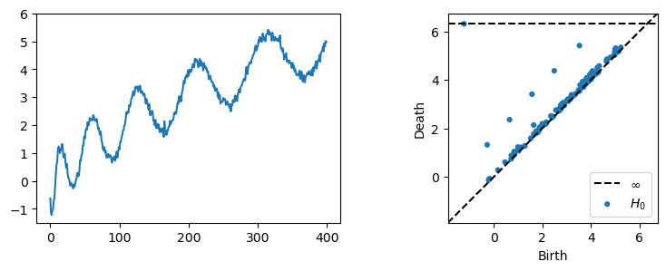
Wasserstein Distance
Stable
Computable
Metric

Slide 7
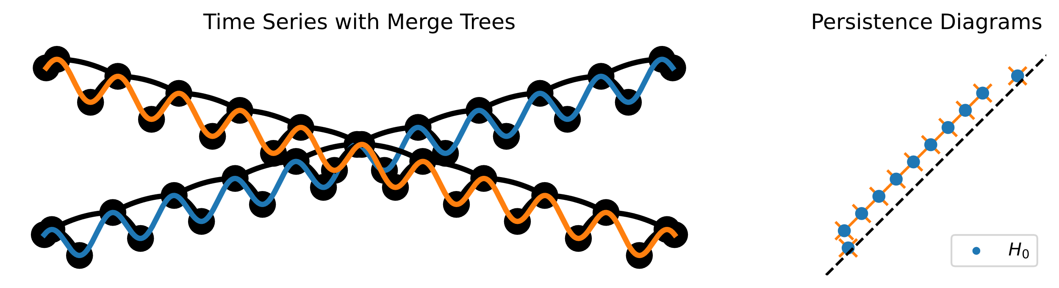
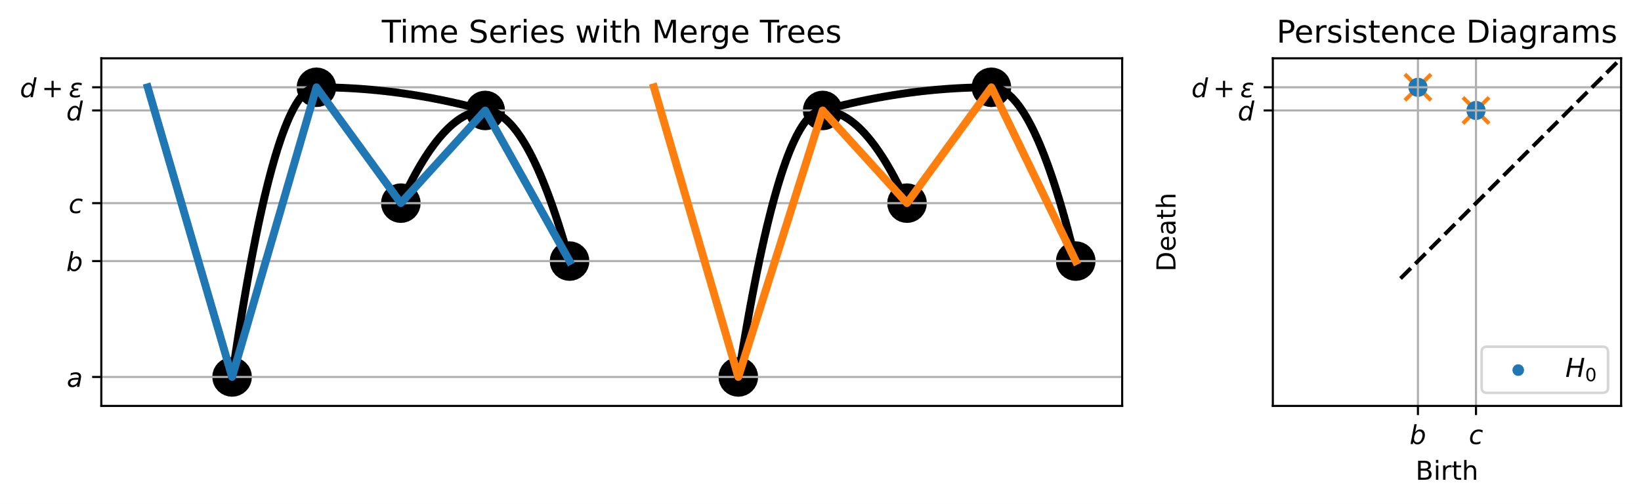
Wasserstein Distance
Stable
Informative
Computable
Metric

Slide 8
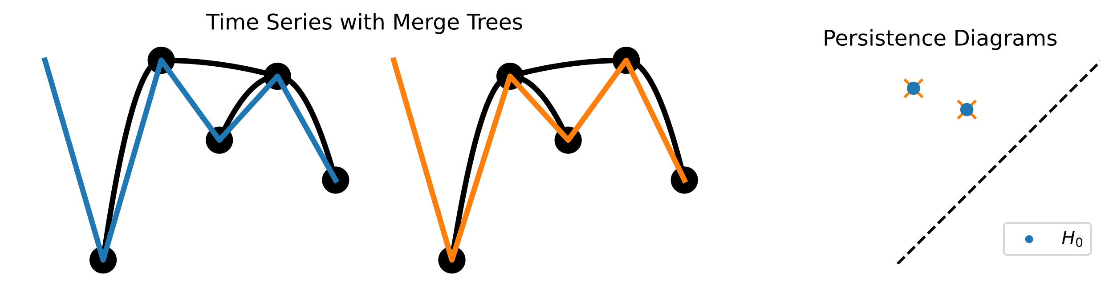
Merge Tree Edit Distance
Stable
Informative
Computable
Metric

Slide 9
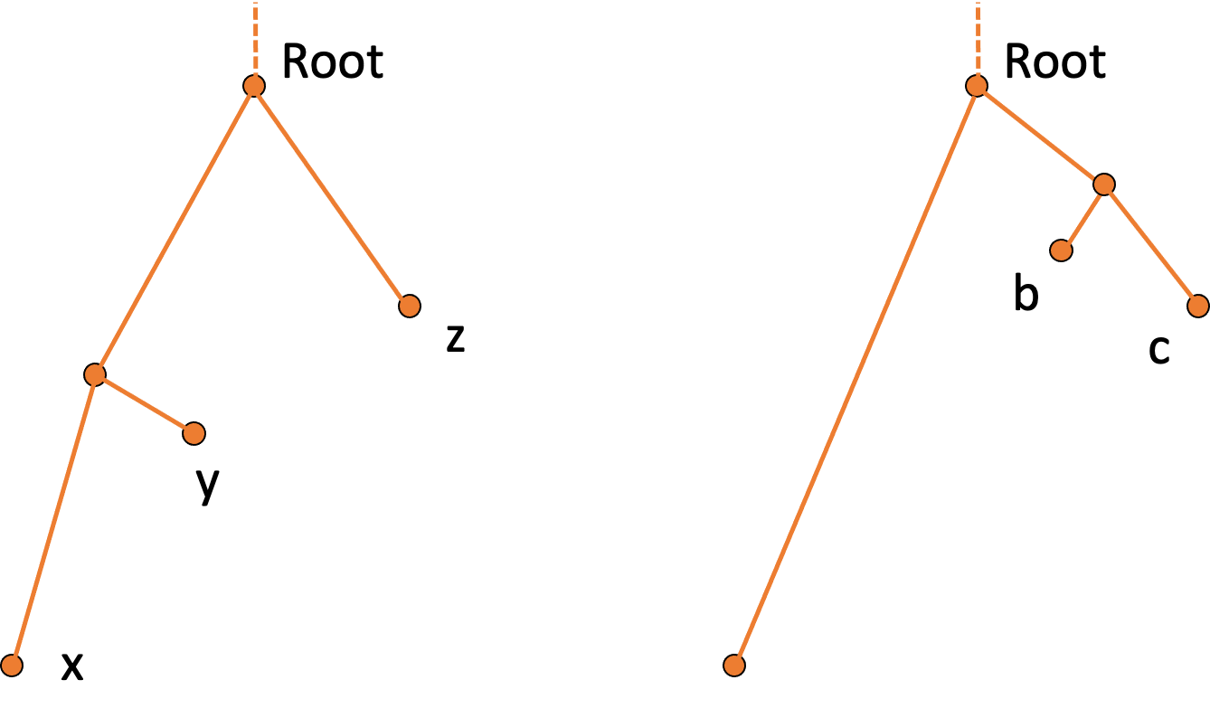
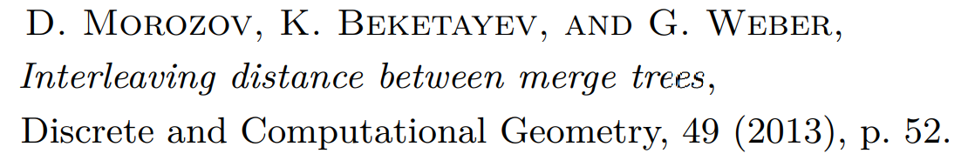

Interleaving Distance
ε
ε
Stable
Informative
Computable
Metric

Slide 10
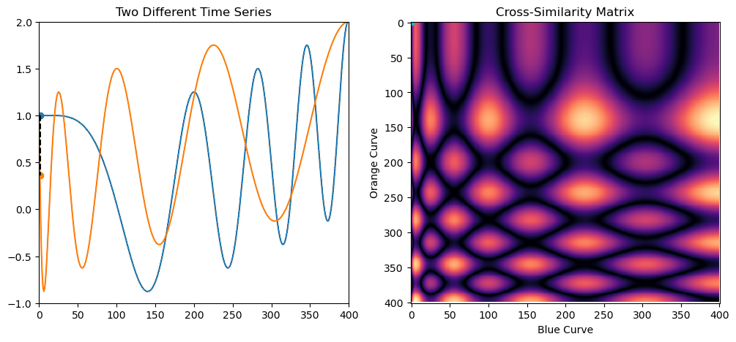
Dynamic Time Warping
Stable
Informative
Computable
Metric

Slide 11

Dynamic Ordered Persistence Editing (DOPE)

Slide 12
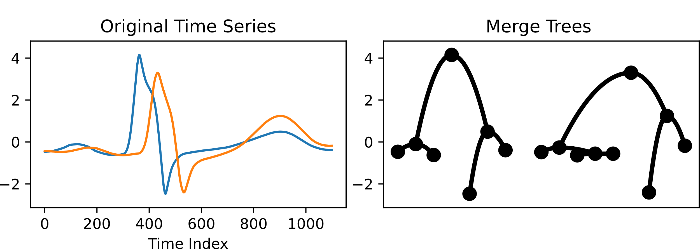
Critical Point Time Series
Ordered domains help us!

Slide 13
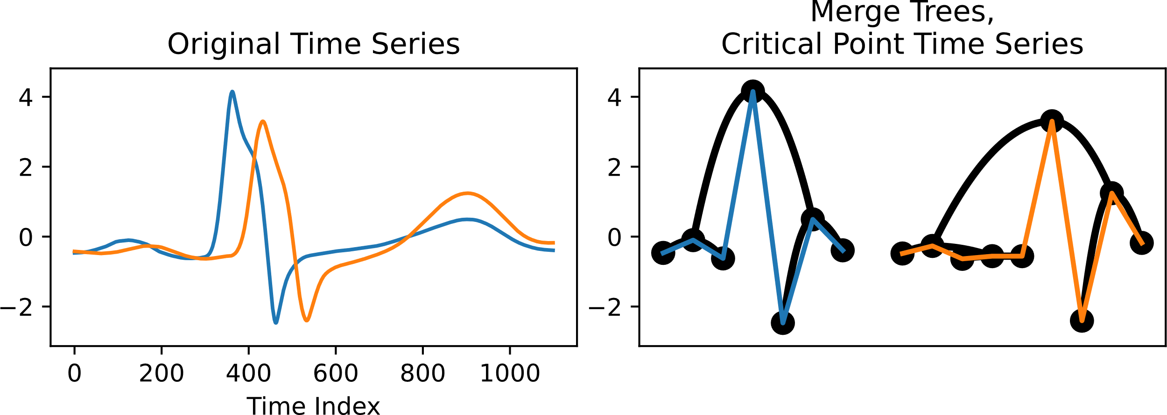
Critical Point Time Series
Inorder traversal of merge tree

Slide 14


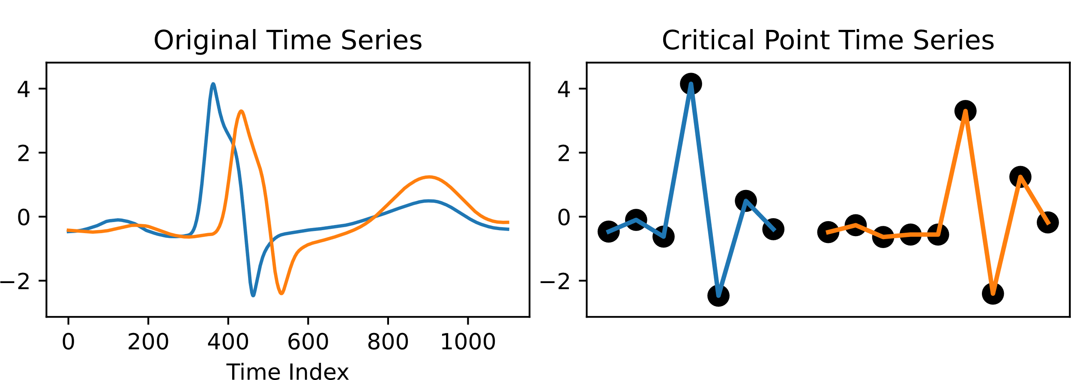
Critical Point Time Series
Throw away the merge tree!

Slide 15
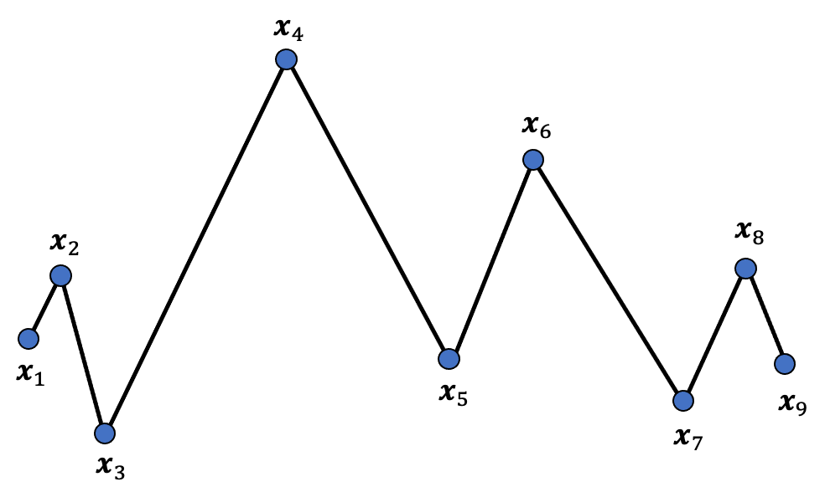
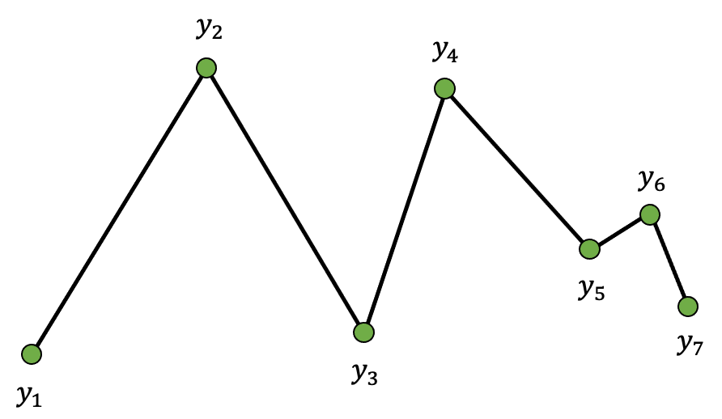


DOPE: Dynamic Ordered Persistence Editing
Two Critical Point Time Series:

Slide 16
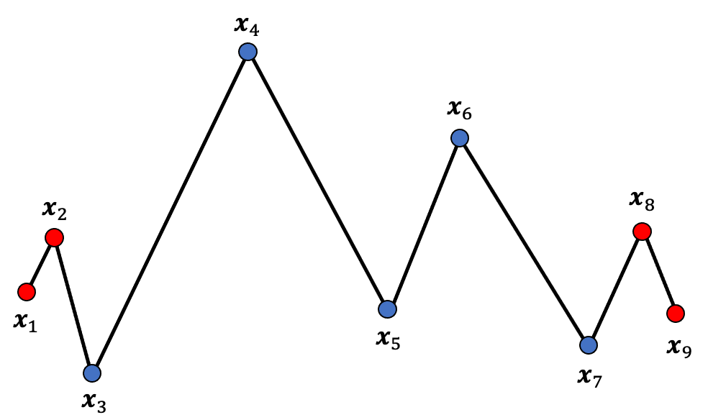
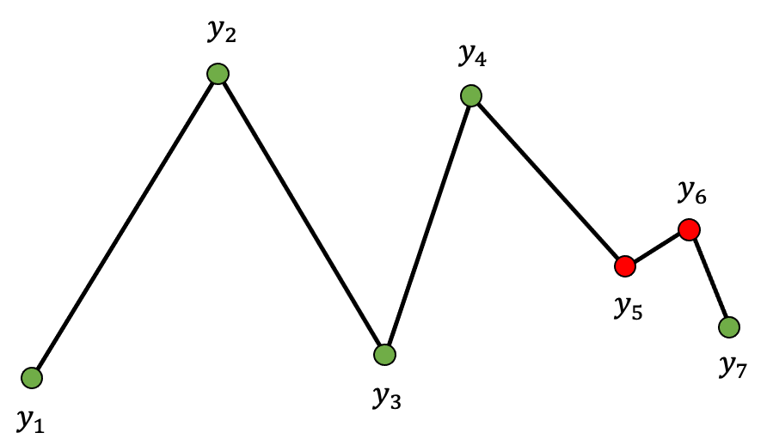
DOPE: Dynamic Ordered Persistence Editing
Edit Operation #1: Deletions of pairs:

Slide 17


DOPE: Dynamic Ordered Persistence Editing
Edit Operation #1: Deletions of pairs:

Slide 18
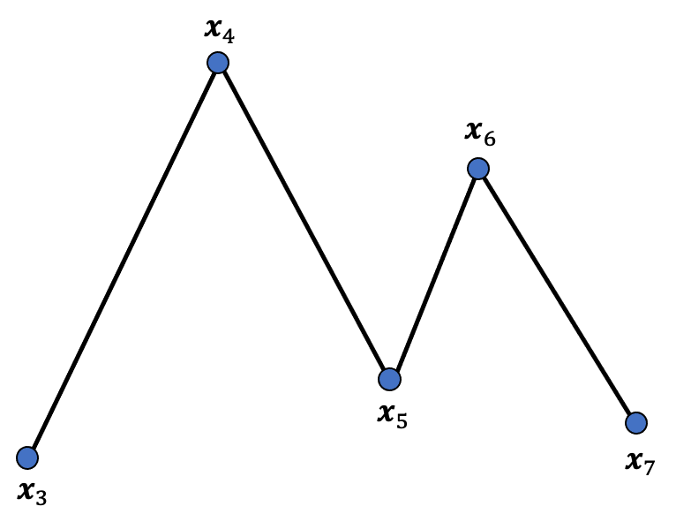
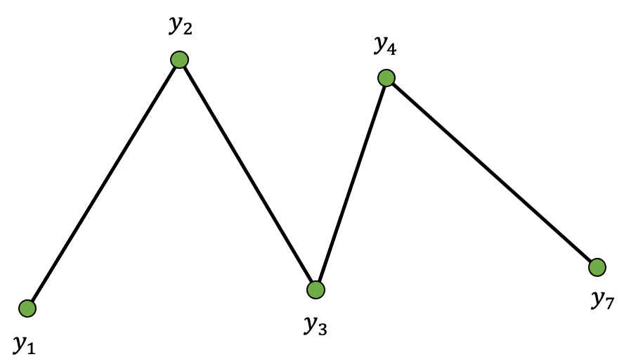
DOPE: Dynamic Ordered Persistence Editing
Deletions:

Slide 19
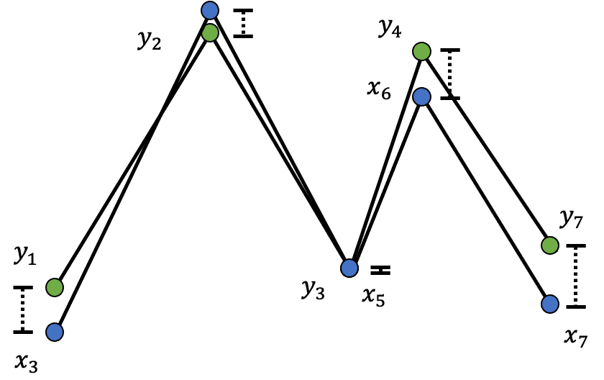
DOPE: Dynamic Ordered Persistence Editing
Edit Operation #2:
Match remaining
points:

Slide 20

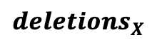

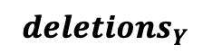

DOPE: Dynamic Ordered Persistence Editing

Slide 21
Dope UCR Example: Phoneme

Slide 22
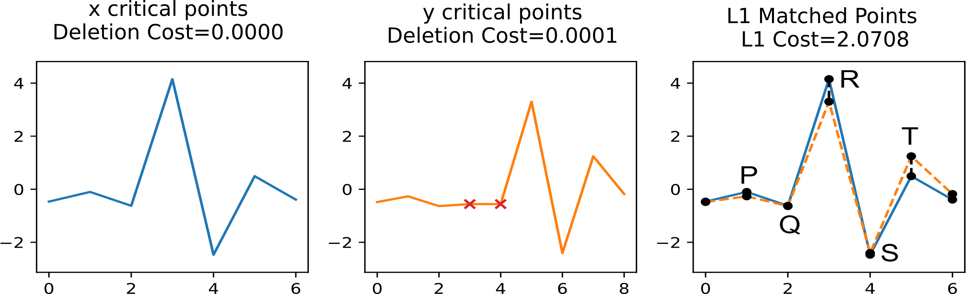
Dope UCR Example: ECG

Slide 23
Dope is stable
Follow from definitions…

Slide 24
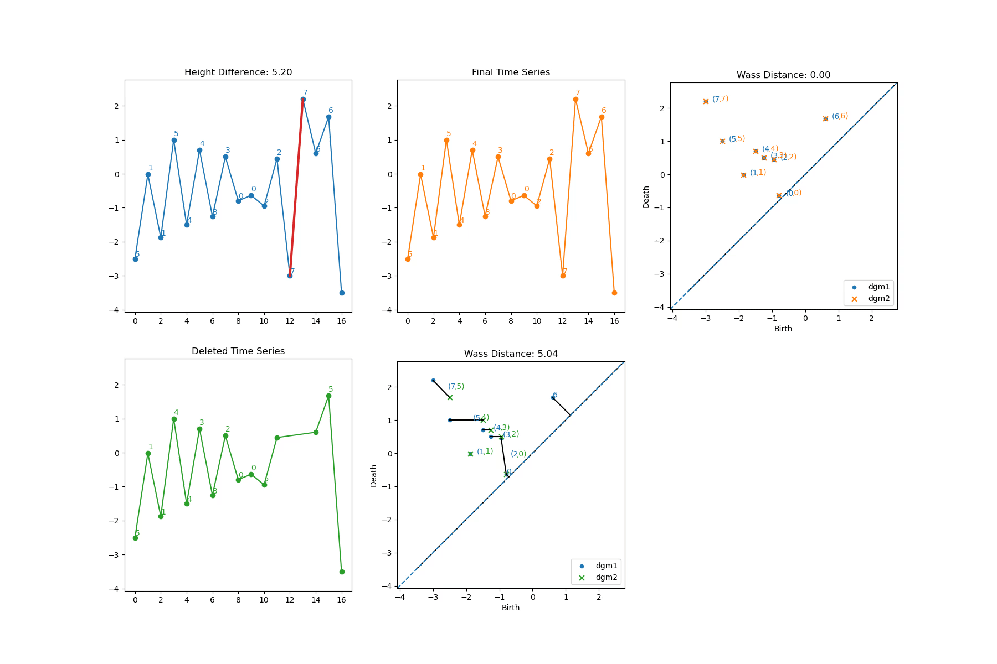
DOPE is L1-Informative

Slide 25
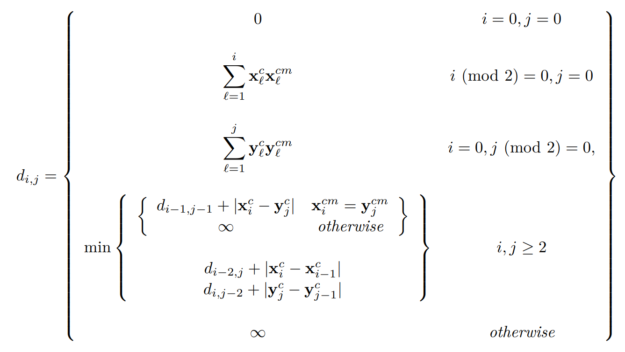
Dope is Computable in O(N²) Time
Base cases
Matching
Deletion

Slide 26
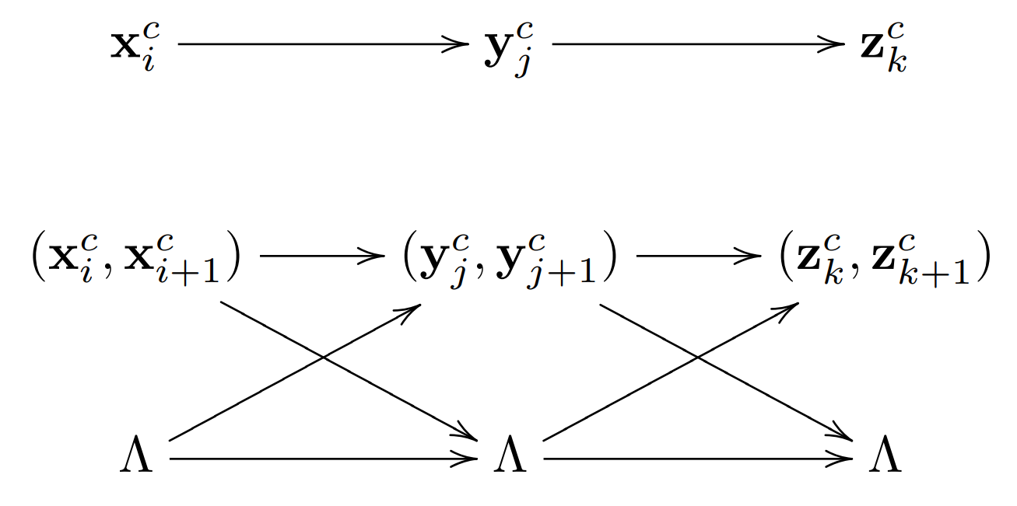
DOPE Is A Metric

Slide 27
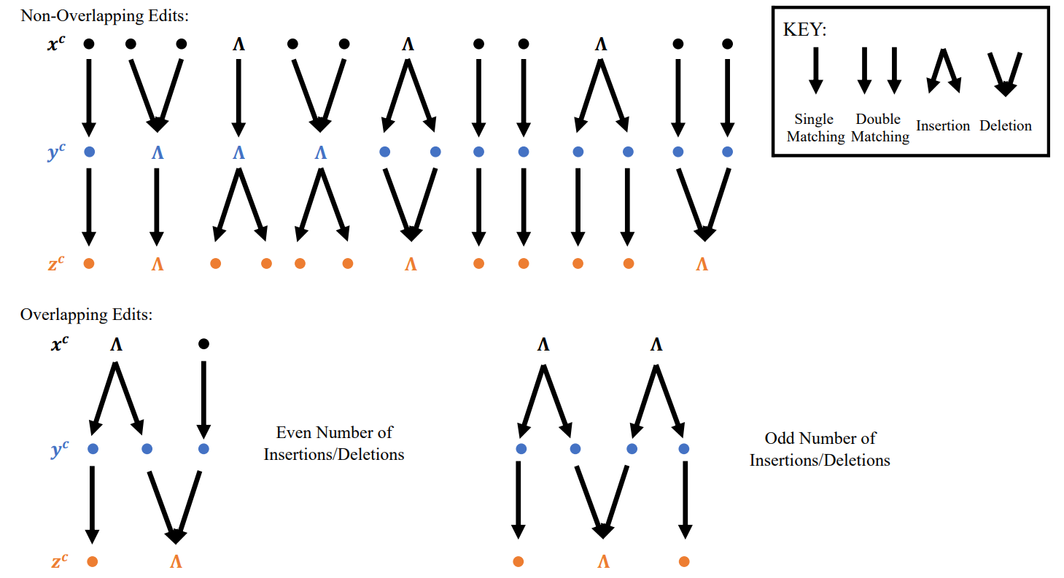
DOPE Is A Metric

Slide 28
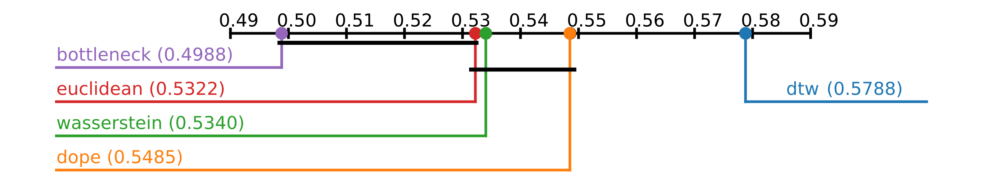
UCR Time Series
128 time series classification problems
Mean Average Precision (MAP)

Slide 29

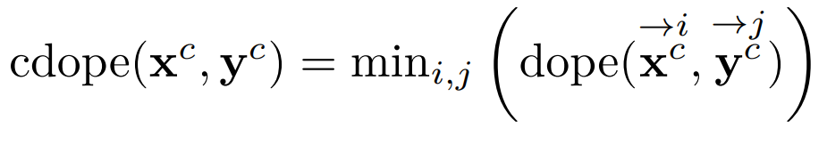
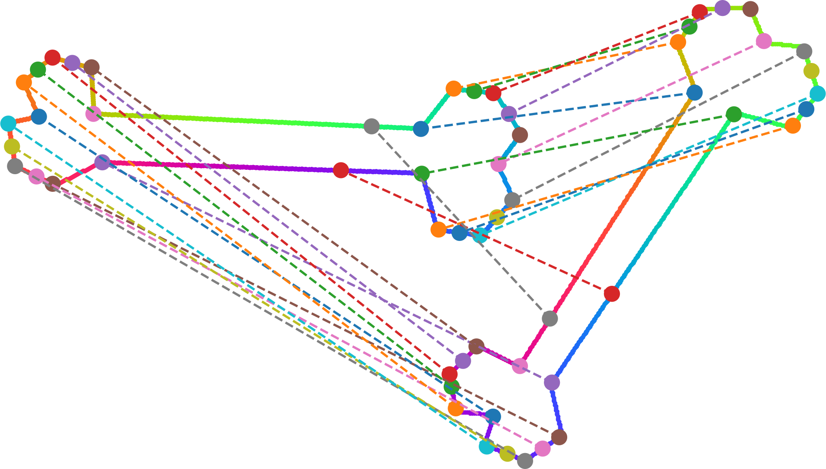
Circular DOPE

Slide 30


Thank you!!
https://arxiv.org/pdf/2212.01648.pdf

Slide 31
Supplementary slides

Slide 32
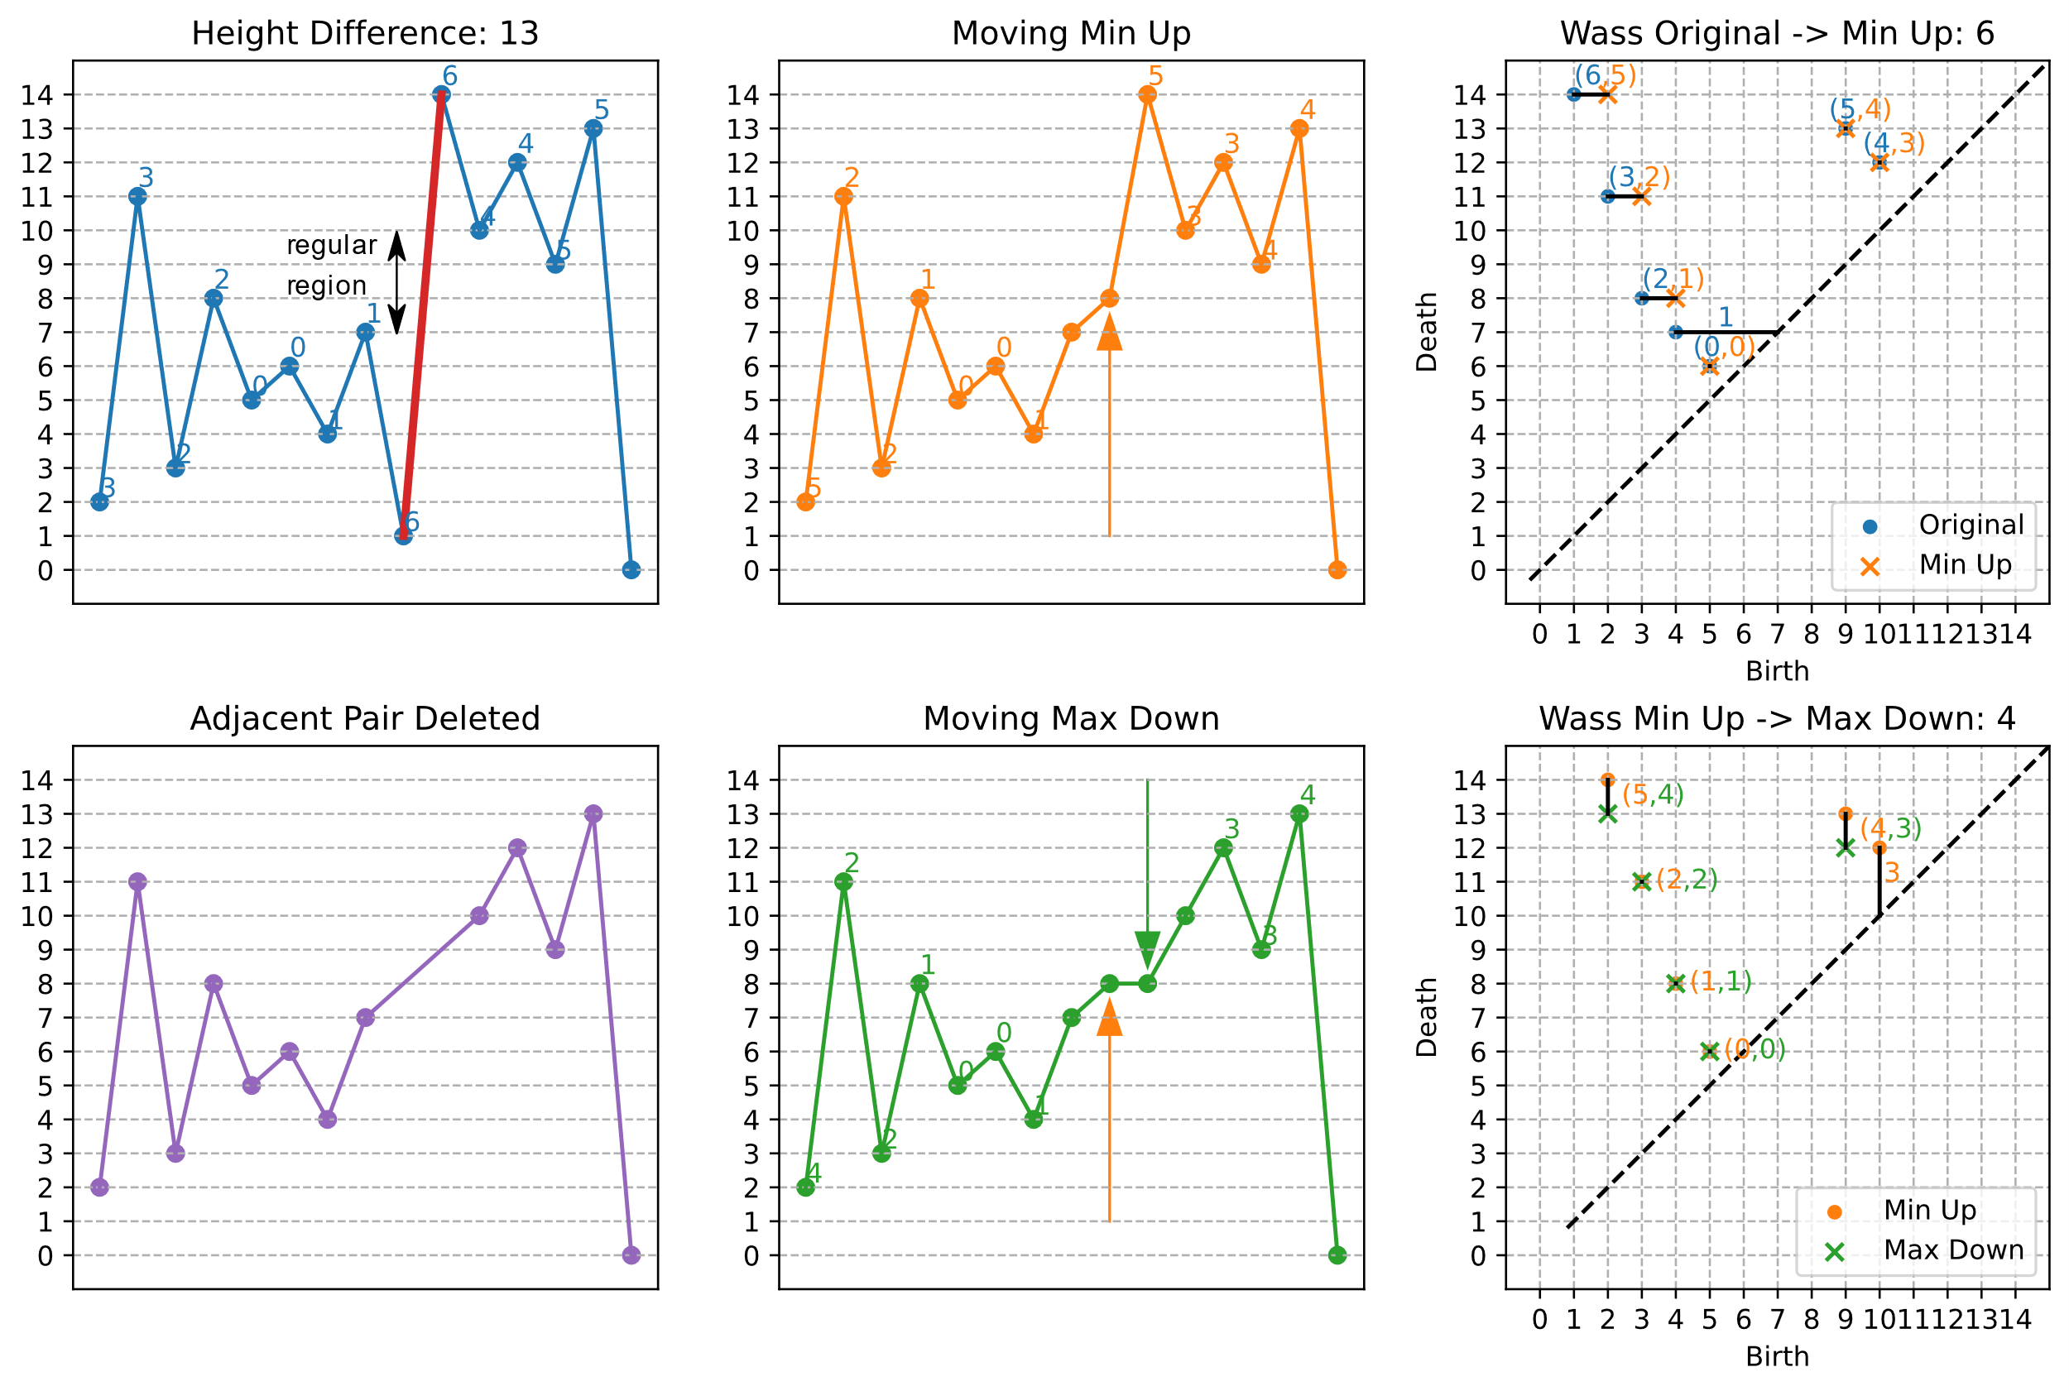
DOPE is L1-Informative

Slide 33
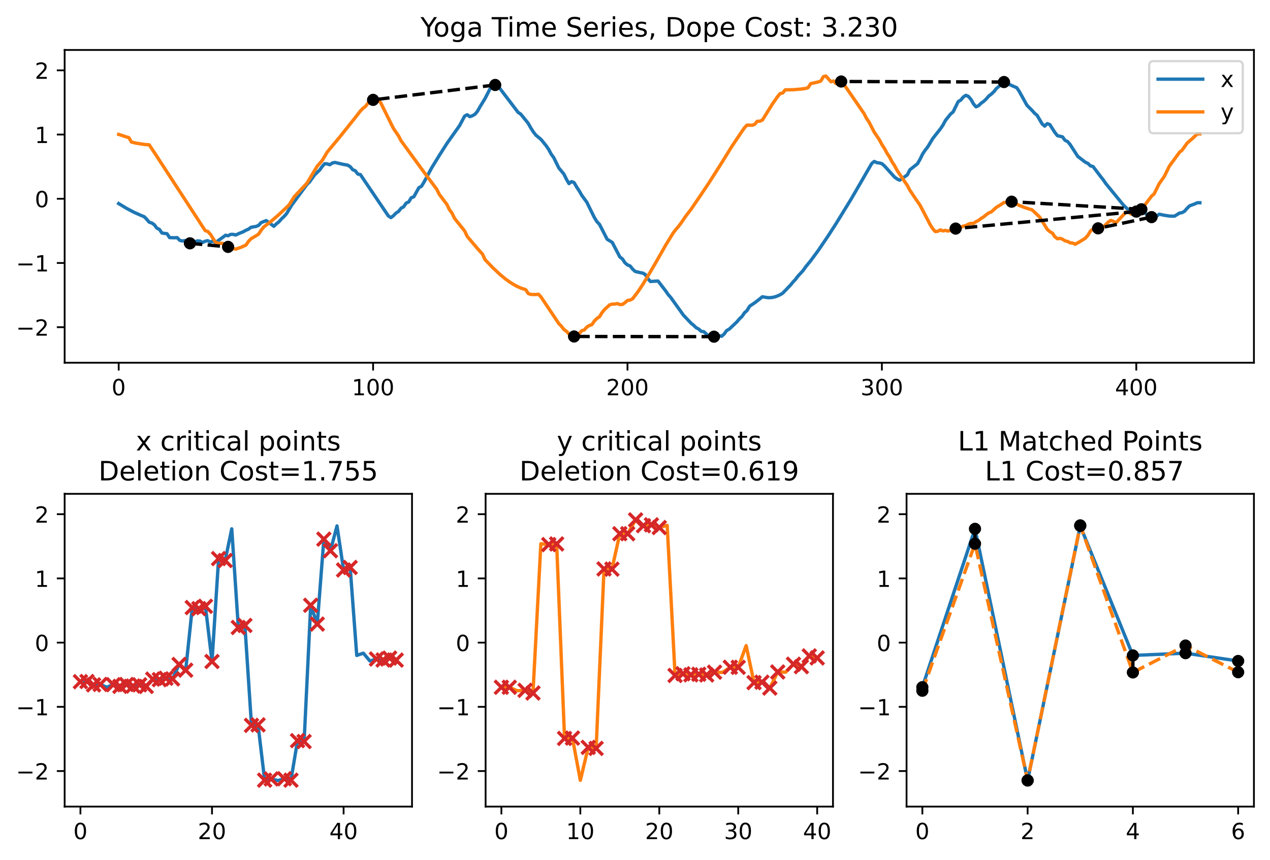
Dope UCR Example: Yoga motions

Slide 34
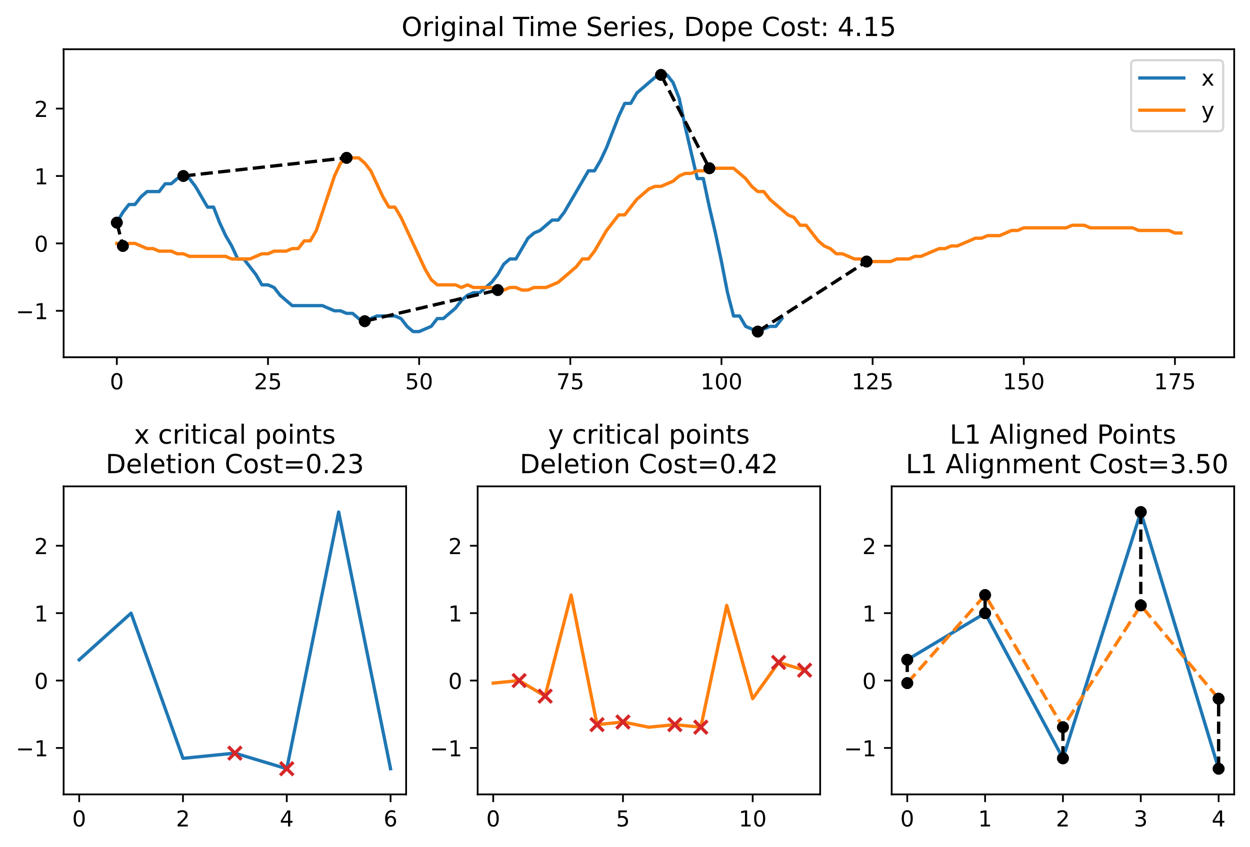
Dope UCR Example: Wii mote motions

Slide 35

Motivation: Time Warped TIme Series

Slide 36
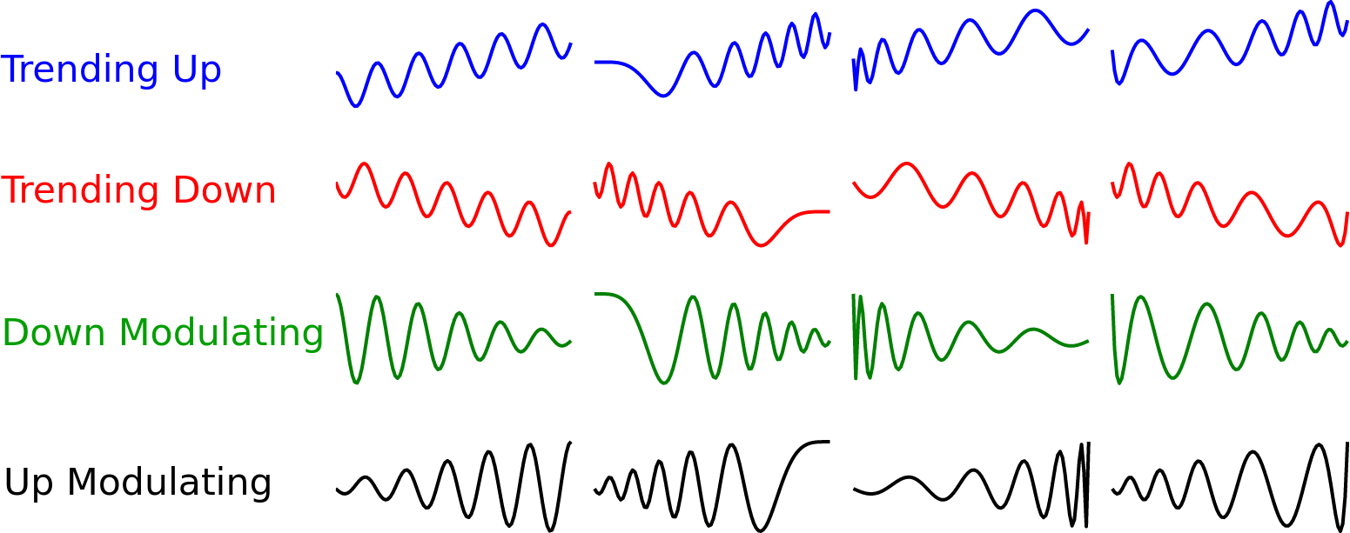
Motivation: Time Warped TIme Series

